Slide 1
Network Transformation Lifecycle Maintenance
Jude F. Ognibene
Sr. Manager
Verizon Maintenance Engineering

Slide 2
Next Gen
Intelligent
Networks
(Core/Edge)
STP
DCS
Voicemail
SS7
SONET
TDM
Telemetry
Analytics
VoIP
Security
MUX
IP
DWDM
Probes
Retired Networks??
SDN
&
NFV
Legacy / Traditional Networks
Notes:
VES:
Helping businesses work.
Global IP and network-based IT solutions.
One of the most connected backbone networks in the world.
Advanced cloud and security services.

Slide 3
THE PROBLEM:
Support aging legacy networks while also supporting a growing portfolio of next-gen technologies
Static/Declining Operating Expenses
Growing liability for support of next-gen network deployments
Increasing support costs on legacy technologies
Increasing limitations on availability of parts and technical support
Availability
Cost
Notes:
VES:
Helping businesses work.
Global IP and network-based IT solutions.
One of the most connected backbone networks in the world.
Advanced cloud and security services.

Slide 4
THE SOLUTION:
…Yeah, that’ll fix everything.
Ask for Better Prices!
Negotiate!
But we only call a few times a year!
Mr. Vendor you’re too expensive!
All we need is T&M!
Notes:
VES:
Helping businesses work.
Global IP and network-based IT solutions.
One of the most connected backbone networks in the world.
Advanced cloud and security services.

Slide 5
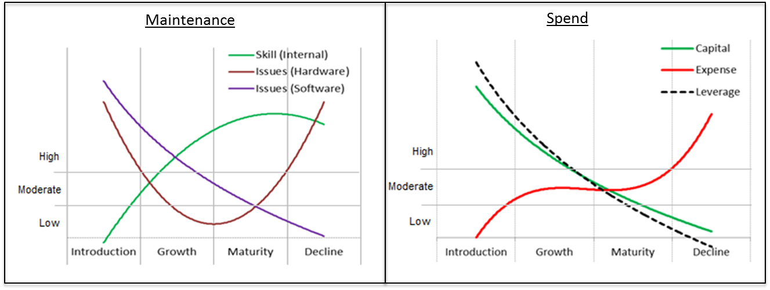
Product Lifecycle Category Model
New/Early
Deployment
Mature
Evolution
Retired??
Sunset
The answer may lie in an attempt to prevent future instances of past mistakes

Slide 6
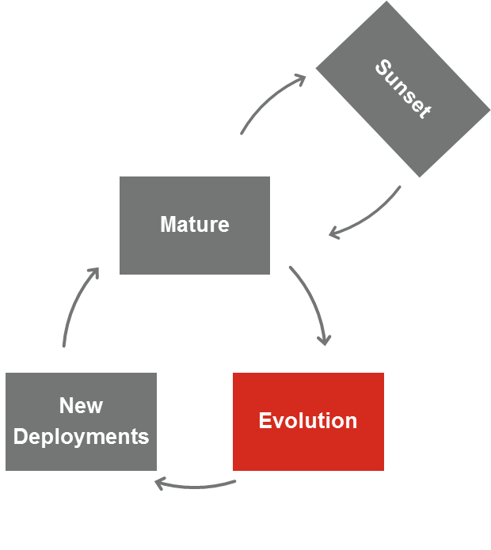
Lifecycle Maintenance Considerations
When you have an attentive audience – Use it Wisely!
Lifecycle management requires governance and while it may be focused on deployment of new technologies, the same team can be chartered/empowered/forced to address legacy concerns.
New & Early Deployment
Wise use of internal and external leverage
Forward Thinking (Future Protections)
Mature (BAU)
Pull all the levers
Benchmarking & iterative SLA Changes
Feedback loop begins / as-needed targeted decoms
Evolution
Triggered by business plans or OEM End of Life
Harvest rewards of Forward Thinking
Wise use of internal leverage
Drive technology migrations
Sunset
Yes Virginia, there is a last day of support
Notes:
VES:
Helping businesses work.
Global IP and network-based IT solutions.
One of the most connected backbone networks in the world.
Advanced cloud and security services.

